Slide 1

Comparative Analysis of ML Algorithms in Drought Prediction
- Dr. Arindam Giri
(Mentor)

Slide 2


OBJECTIVE
Forecasting Drought is exceedingly challenging due to complexity of Earth’s climate. This Project will predict in advance using
ML Algorithms.

Slide 3


Requirements::
Python
Numpy
Pandas
Scikit Learn
Google Colab
Dataset:
https://droughtmonitor.unl.edu/DmData/DataDownload.aspx

Slide 4
Data Collection
Data Wrangling
Exploratory Data Analysis
Feature Selection and Extraction
Model Development
Model Evaluation
Data Process Lifecycle

Slide 5
Attribute Description
Indicator | Description
WS10M_MIN | Minimum Wind Speed at 10 Meters (m/s)
QV2M | Specific Humidity at 2 Meters (g/kg)
T2M_RANGE | Temperature Range at 2 Meters (C)
WS10M | Wind Speed at 10 Meters (m/s)
T2M | Temperature at 2 Meters (C)
WS50M_MIN | Minimum Wind Speed at 50 Meters (m/s)
T2M_MAX | Maximum Temperature at 2 Meters (C)
WS50M | Wind Speed at 50 Meters (m/s)
TS | Earth Skin Temperature (C)
Indicator | Description
WS50M_RANGE | Wind Speed Range at 50 Meters (m/s)
WS50M_MAX | Maximum Wind Speed at 50 Meters (m/s)
WS10M_MAX | Maximum Wind Speed at 10 Meters (m/s)
WS10M_RANGE | Wind Speed Range at 10 Meters (m/s)
PS | Surface Pressure (kPa)
T2MDEW | Dew/Frost Point at 2 Meters (C)
T2M_MIN | Minimum Temperature at 2 Meters (C)
T2MWET | Wet Bulb Temperature at 2 Meters (C)
PRECTOT | Precipitation (mm day-1)

Slide 6
Category | Description | Possible Impacts
D0 | Abnormally Dry | Going into drought: short-term dryness slowing planting, growth of crops or pastures Coming out of drought: some lingering water deficits pastures or crops not fully recovered
D1 | Moderate Drought | Some damage to crops, pastures Streams, reservoirs, or wells low, some water shortages developing or imminent Voluntary water-use restrictions requested
D2 | Severe Drought | Crop or pasture losses likely Water shortages common Water restrictions imposed
D3 | Extreme Drought | Major crop/pasture losses Widespread water shortages or restrictions
D4 | Exceptional Drought | Exceptional and widespread crop/pasture losses Shortages of water in resertoirs, streams, and wells creating Water emergencies

Slide 7
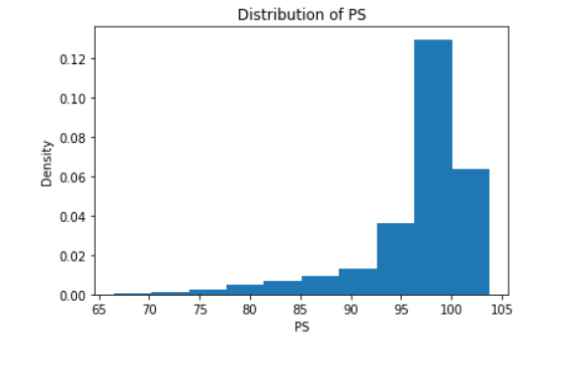
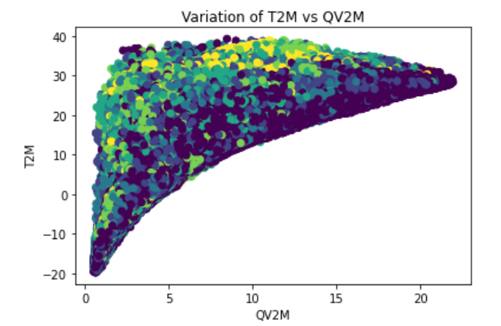
Univariate Analysis and Bivariate Analysis

Slide 8
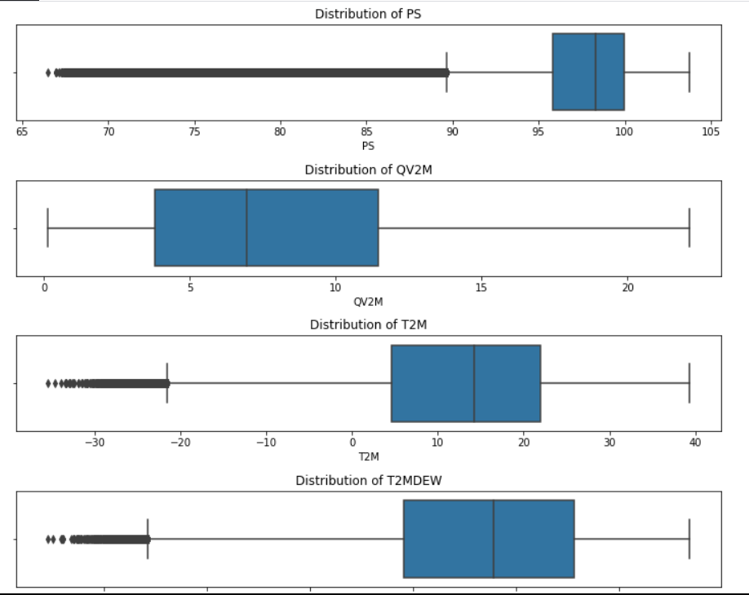
Outliers Treatment

Slide 9
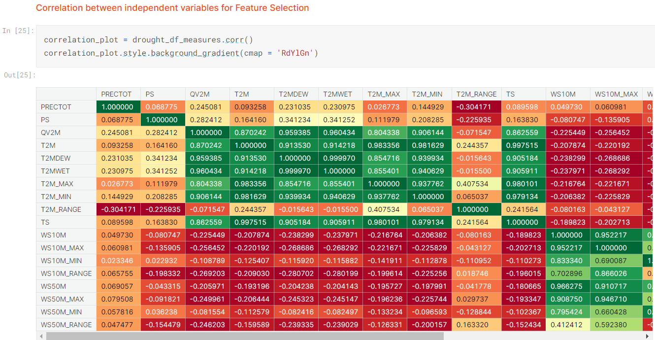
Attributes QV2M, T2M, T2MDEW, T2MWET, T2M_MAX, T2M_MIN and TS have shown strong positive correlation
Similarly WS10M, WS10M_MAX and WS10M_MIN have shown a strong positve correlation
Likewise, WS50M, WS50M_MAX and WS50M_MIN show strong positive correlation
However, from the scatter plots above, we see significant variance between the data points, despite the strong positive correlation. Hence we'll retain all these variables, and try other feature selection methods.

Slide 10
Features Selected For Model Development
Indicator | Description
year | Specifies the year
QV2M. | Specific Humidity at 2 Meters (g/kg)
T2M_RANGE. | Temperature Range at 2 Meters (C)
WS10M. | Wind Speed at 10 Meters (m/s)
T2M. | Temperature at 2 Meters (C)
day | Specifies the day
T2M_MAX. | Maximum Temperature at 2 Meters (C)
WS50M. | Wind Speed at 50 Meters (m/s)
Indicator | Description
WS50M_RANGE. | Wind Speed Range at 50 Meters (m/s)
WS50M_MAX. | Maximum Wind Speed at 50 Meters (m/s)
WS10M_RANGE. | Wind Speed Range at 10 Meters (m/s)
PS. | Surface Pressure (kPa)
T2MDEW. | Dew/Frost Point at 2 Meters (C)
T2M_MIN. | Minimum Temperature at 2 Meters (C)
TS. | Earth Skin Temperature (C)

Slide 11
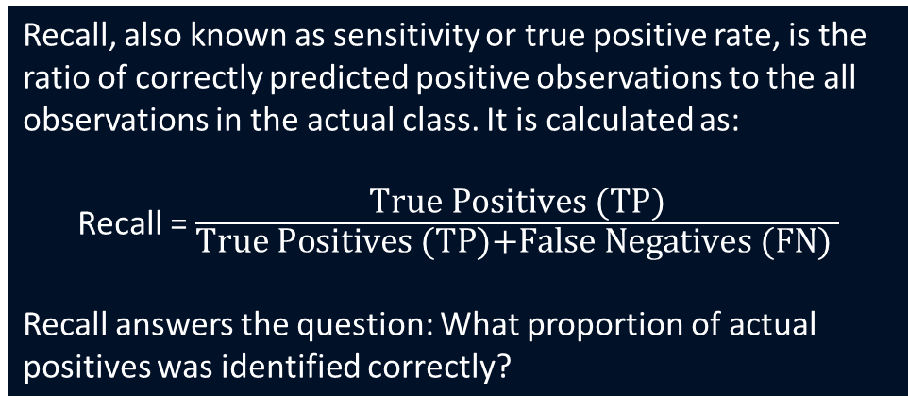
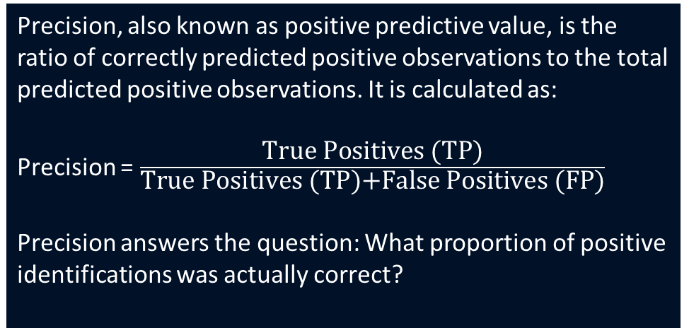
Metrics For Performance Analysis
Recall, also known as sensitivity or true positive rate, is the ratio of correctly predicted positive observations to the all observations in the actual class. It is calculated as:
Recall = $\frac{\text{True} \text{Positives}\text{ (}\text{TP}\text{)}}{\text{True} \text{Positives}\text{ (}\text{TP}\text{)+}\text{False} \text{Negatives}\text{ (}\text{FN}\text{) }}$
Recall answers the question: What proportion of actual positives was identified correctly?
Precision, also known as positive predictive value, is the ratio of correctly predicted positive observations to the total predicted positive observations. It is calculated as:
Precision = $\frac{\text{True} \text{Positives}\text{ (}\text{TP}\text{)}}{\text{True} \text{Positives}\text{ (}\text{TP}\text{)+}\text{False} \text{Positives}\text{ (}\text{FP}\text{)}}$
Precision answers the question: What proportion of positive identifications was actually correct?

Slide 12
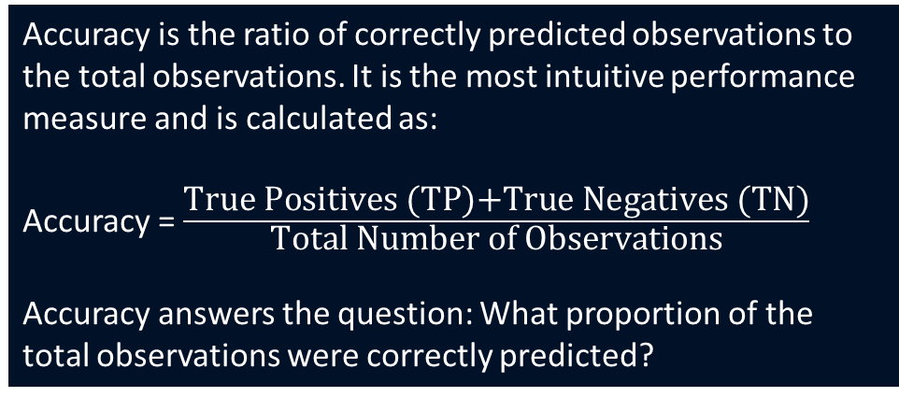
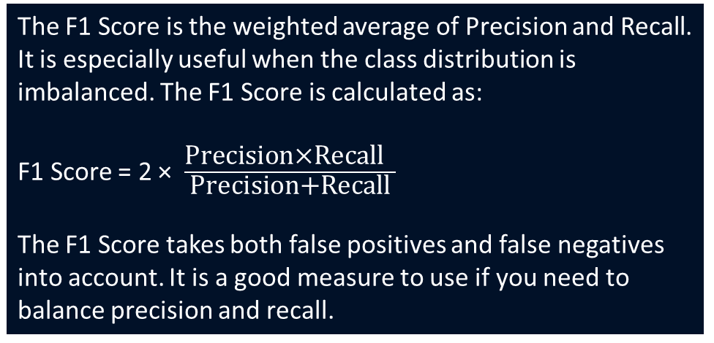
Metrics For Performance Analysis
Accuracy is the ratio of correctly predicted observations to the total observations. It is the most intuitive performance measure and is calculated as:
Accuracy = $\frac{\text{True} \text{Positives}\text{ (}\text{TP}\text{)+}\text{True} \text{Negatives}\text{ (}\text{TN}\text{)}}{\text{Total} \text{Number} \text{of} \text{Observations}}$
​
Accuracy answers the question: What proportion of the total observations were correctly predicted?
The F1 Score is the weighted average of Precision and Recall. It is especially useful when the class distribution is imbalanced. The F1 Score is calculated as:
F1 Score = 2 × $\frac{\text{Precision}\text{×}\text{Recall}\text{​ }}{\text{Precision}\text{+}\text{Recal}\text{l}}$
The F1 Score takes both false positives and false negatives into account. It is a good measure to use if you need to balance precision and recall.

Slide 13
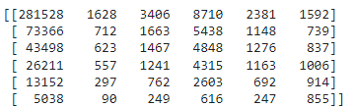
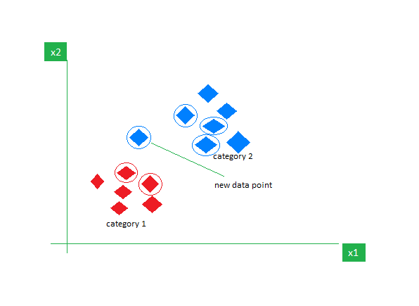
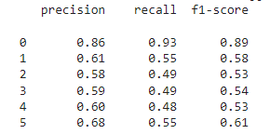
K-Nearest Neighbors (KNN)
K-Nearest Neighbors (KNN) is a non-parametric algorithm that classifies data points based on the majority class of their k-nearest neighbors in the feature space.
Confusion Matrix

Slide 14
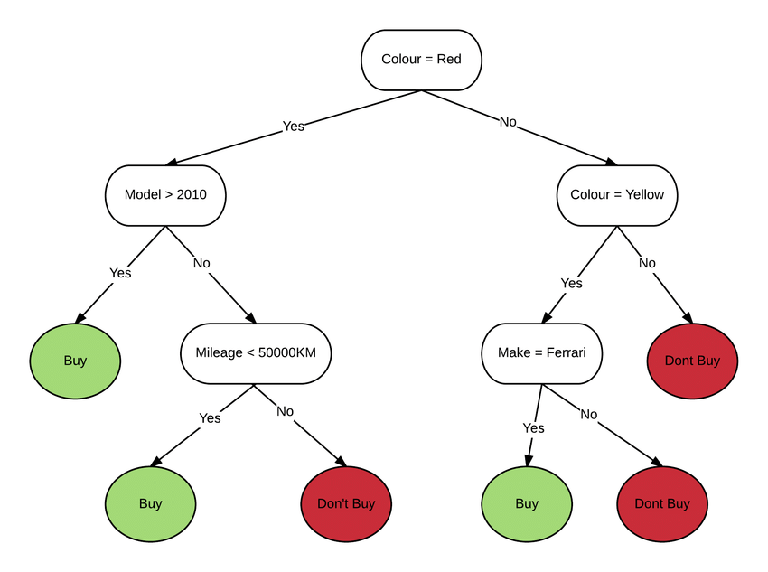
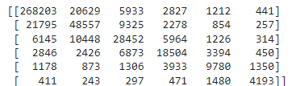
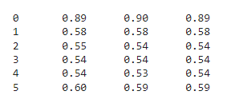
Decision Tree
A decision support hierarchical model that uses a tree-like model of decisions and their possible consequences
Confusion Matrix:

Slide 15
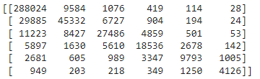
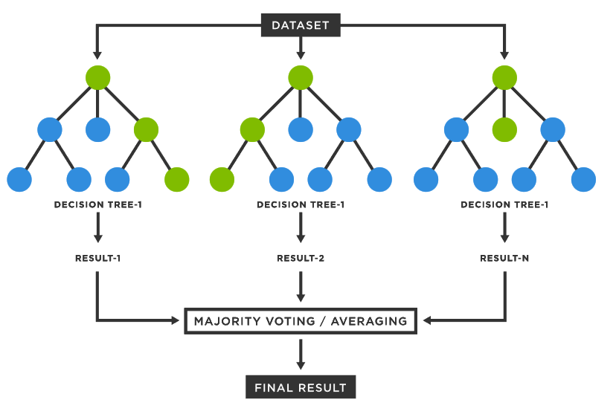
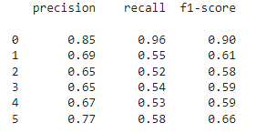
Random Forest
Random Forest is an ensemble learning method in machine learning that constructs multiple decision trees for classification or regression, improving accuracy and preventing overfitting.
Confusion Matrix

Slide 16
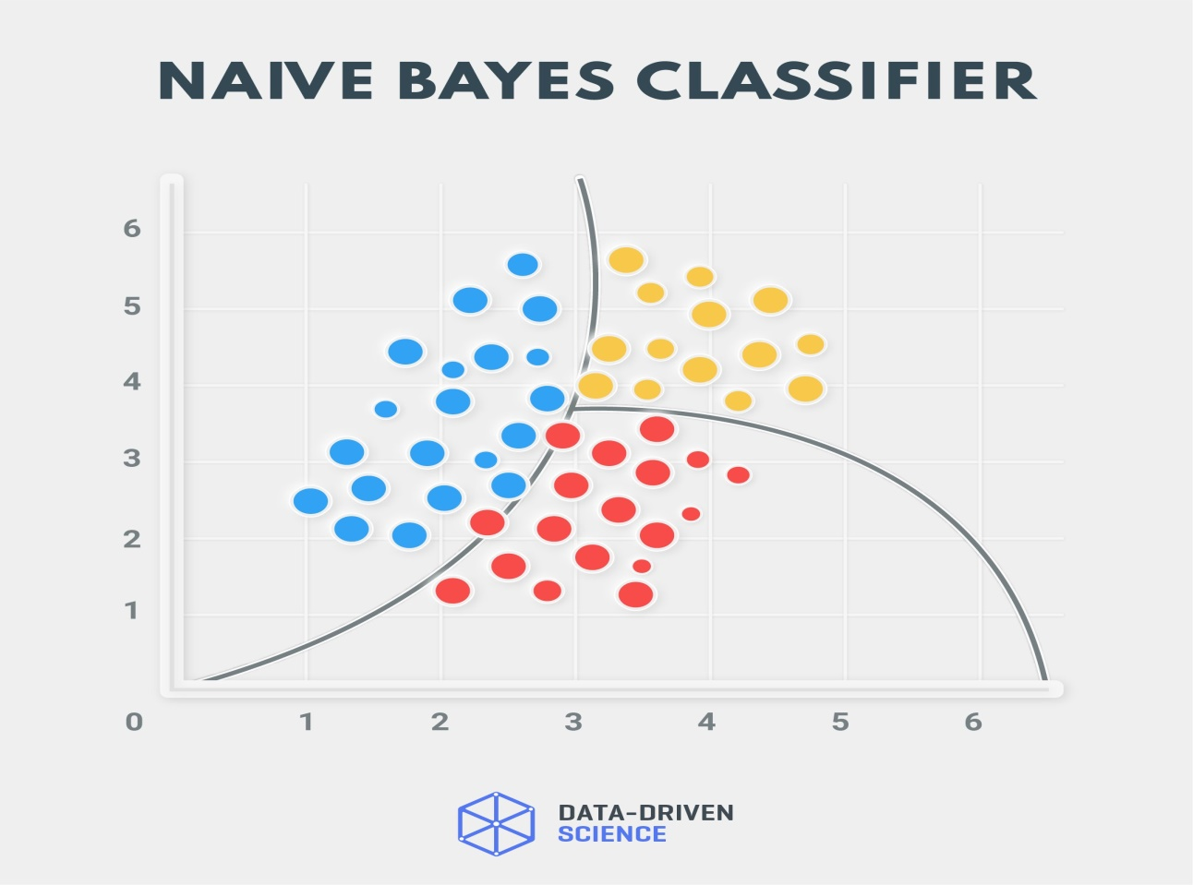
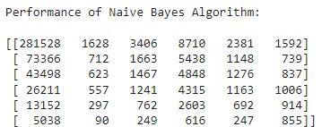
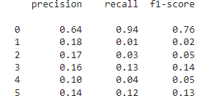
Naive Bayes Algorithm
Naive Bayes is a probabilistic machine learning algorithm that uses Bayes' theorem with the assumption of feature independence for classification tasks, like spam detection.
Confusion Matrix

Slide 17
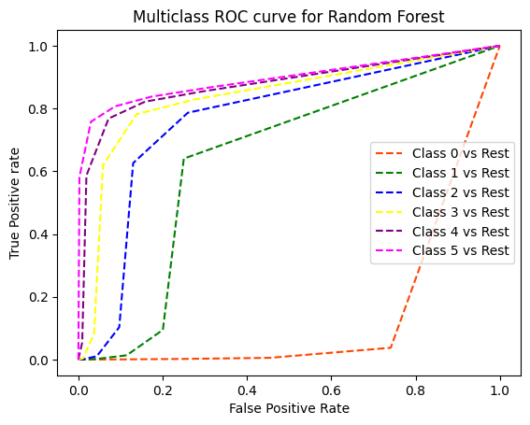
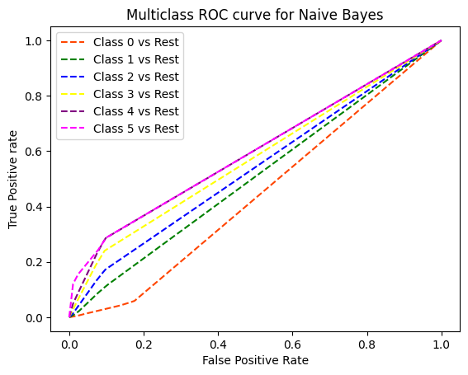
ROC Curve for ML Algorithms Used

Slide 18
Comparative Analysis Of ML Algorithms
Used For Drought Prediction
Algorithm | Accuracy | Precision | Recall | F1 Score
Random Forest | 0.794751 | 0.780833 | 0.794751 | 0.782659
KNN | 0.769185 | 0.449910 | 0.769185 | 0.759721
Decision Tree | 0.763094 | 0.762074 | 0.763094 | 0.762573
Naive Bayes | 0.585144 | 0.449910 | 0.585144 | 0.480441
In conclusion, Random Forest emerges as the best-performing algorithm, followed closely by Decision Tree, while KNN and Naive Bayes lag behind, particularly in terms of precision and F1 Score.

Slide 19
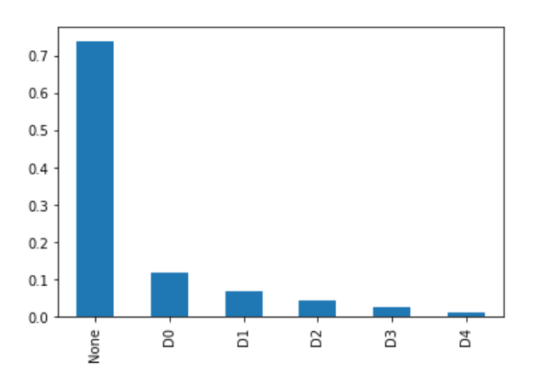
CHALLENGES :
Data Volume - 2 Million + records, made processing too complex in terms of time and application memory.
Class Imbalance - Heavily imbalanced data with over 1.7M records (60%) for class 0 alone.

Slide 20

Priyanshu
Kritik Tiwary
Mayank Kumar
Rahul Raman

